Slide 1

Deep Neural Network Module # 7: RNN
DNN Team
BITS Pilani WILP

Slide 2
The instructor is gratefully acknowledging the authors who made their course materials freely available online.
This deck is prepared by Seetha Parameswaran.
Deep Neural Network

Slide 3










Table of Contents
Introduction to Sequence Modeling
Sequence Models Theory
Basic RNN Architecture
RNN Training & BPTT
Bidirectional RNNs
Deep (Stacked) RNNs
Gated Recurrent Units (GRU)
Long Short-Term Memory (LSTM)
Time Series Forecasting Applications
Comparison & Summary
1
2
3
4
5
6
7
8
9
10
Deep Neural Network

Slide 4


Motivation: Why Sequence Models?
Many real-world problems involve sequential data:
⁾ Natural Language: ”The cat sat on the ”
⁾ Time Series Forecasting: Stock prices, temperature prediction, sensor data
⁾ Speech: Audio signals over time
⁾ Video: Frame sequences
⁾ Genomics: DNA/protein sequences Key characteristic: Order matters Dependencies exist across time steps
The
cat sat ^{on}
the
?
Dependencies
Deep Neural Network

Slide 5
Why Feedforward Networks Fail?
Key issues:
⁾ Fixed input size: Cannot handle variable-length sequences
⁾ No memory: Each input processed independently
⁾ No parameter sharing: Different weights for each position
Example Problem: Predict next word in a sentence
⁾ Input: ”I grew up in France, so I speak fluent ”
⁾ Need context from 7 words back (”France”) to predict ”French”
⁾ Feedforward network treats each position independently
We need: A model that can remember past information
Deep Neural Network
5 / 96

Slide 6
Temporal Dependencies
Short-term dependencies: Information needed is recent
⁾ ”The clouds are in the ” → ”sky”
Long-term dependencies: Information needed is far back
⁾ ”I grew up in France... I speak fluent ” → ”French”
Challenge: Model must learn to remember relevant information and forget irrelevant information.
Different sequence lengths require flexible architectures
Deep Neural Network

Slide 7


Table of Contents
Introduction to Sequence Modeling
Sequence Models Theory
Basic RNN Architecture
RNN Training & BPTT
Bidirectional RNNs
Deep (Stacked) RNNs
Gated Recurrent Units (GRU)
Long Short-Term Memory (LSTM)
Time Series Forecasting Applications
Comparison & Summary
1
2
3
4
5
6
7
8
9
10
Deep Neural Network

Slide 8
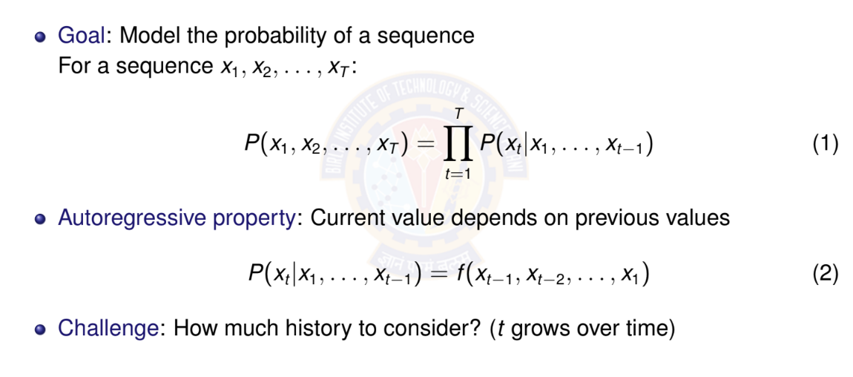
Autoregressive Models
Deep Neural Network

Slide 9
Autoregressive Models: Example
Sequence: ”The cat sat on the” Predict: Next word (e.g., ”mat”) Autoregressive decomposition:
P (The, cat, sat, on, the, mat) = P(The)
× P(cat|The)
× P(sat|The, cat)
× P(on|The, cat, sat)
× P(the|The, cat, sat, on)
× P(mat|The, cat, sat, on, the)
⁾ Each word depends on ALL previous words
⁾ History grows with sequence length
Deep Neural Network

Slide 10
Markov Assumption
Simplification: Limit the context window
First-order Markov: Only immediate past matters
P(x_{t} |x₁, . . . , x_{t —1}) ≈ P(x_{t} |x_{t —1})
(3)
k -th order Markov: Last k steps matter
P(x_{t} |x₁, . . . , x_{t —1}) ≈ P(x_{t} |x_{t —k} , . . . , x_{t —1})
(4)
Advantage: Fixed-size context, tractable computation Disadvantage: May lose important long-term dependencies
Deep Neural Network

Slide 11
Markov Assumption: Example
Sequence: ”The cat sat on the” Predict: Next word (e.g., ”mat”) First-order Markov (bigram):
P(mat|The, cat, sat, on, the) ≈ P(mat|the)
Second-order Markov (trigram):
P(mat|The, cat, sat, on, the) ≈ P(mat|on, the)
Key insight:
⁾ Fixed context window (1 or 2 words)
⁾ Ignores earlier words like ”cat” and ”sat”
⁾ Computationally efficient but limited expressiveness
Deep Neural Network

Slide 12
Latent Variable Models
Alternative approach: Summarize past with a hidden state
h_{t} = f (x_{t} , h_{t —1})
P(x_{t} |x₁, . . . , x_{t —1}) = P(x_{t} |h_{t} )
(5)
(6)
Key insight:
⁾ h_{t} is a latent (hidden) variable
⁾ Contains compressed summary of history
⁾ Fixed-size representation regardless of sequence length
⁾ Updated recursively at each time step
This is the foundation of RNNs!
Deep Neural Network

Slide 13
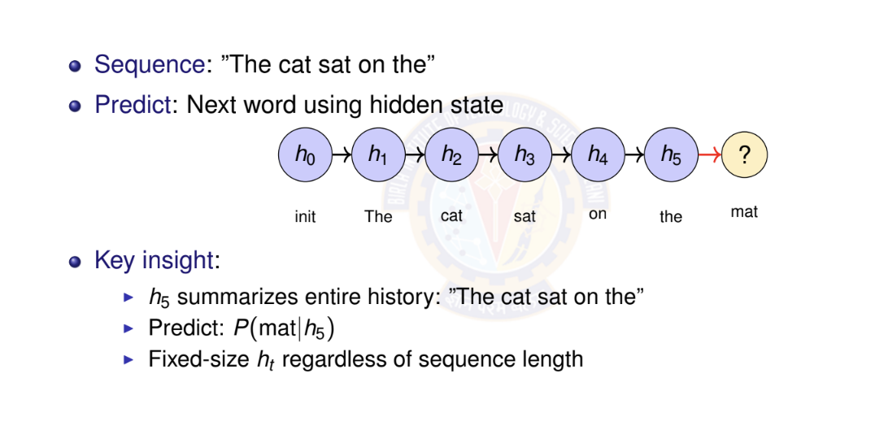
Latent Variable Models: Example
Deep Neural Network

Slide 14
Numerical Example: Temperature Forecasting - Setup
Task: Predict tomorrow’s temperature (regression) Observed sequence: 20◦C, 22◦C, 25◦C, 24◦C, 21◦C Approach 1: Autoregressive (First-order)
⁾ Linear relationship learned from data:
T_{t +1} = α · T_{t} + β
⁾ From historical data, we learned:
α = 0.8, β = 4.0
⁾ Example: If today is 25◦C:
T_{tomorrow} = 0.8 × 25 + 4.0 = 24.0◦C
Deep Neural Network

Slide 15
Temperature Forecasting - Autoregressive Prediction
Sequence: 20◦C, 22◦C, 25◦C, 24◦C, 21◦C Model: T_{t +1} = 0.8 · T_{t} + 4.0
Predict next day (day 6):
⁾ Last observation: T₅ = 21◦C
⁾ Prediction: T₆ = 0.8 × 21 + 4.0 = 20.8◦C
Multi-step ahead (day 7, using predicted T₆):
⁾ T₇ = 0.8 × 20.8 + 4.0 = 20.64◦C
Limitation: Only uses immediate past
⁾ Cannot capture weekly/seasonal patterns
⁾ Error accumulates in multi-step predictions
Deep Neural Network

Slide 16
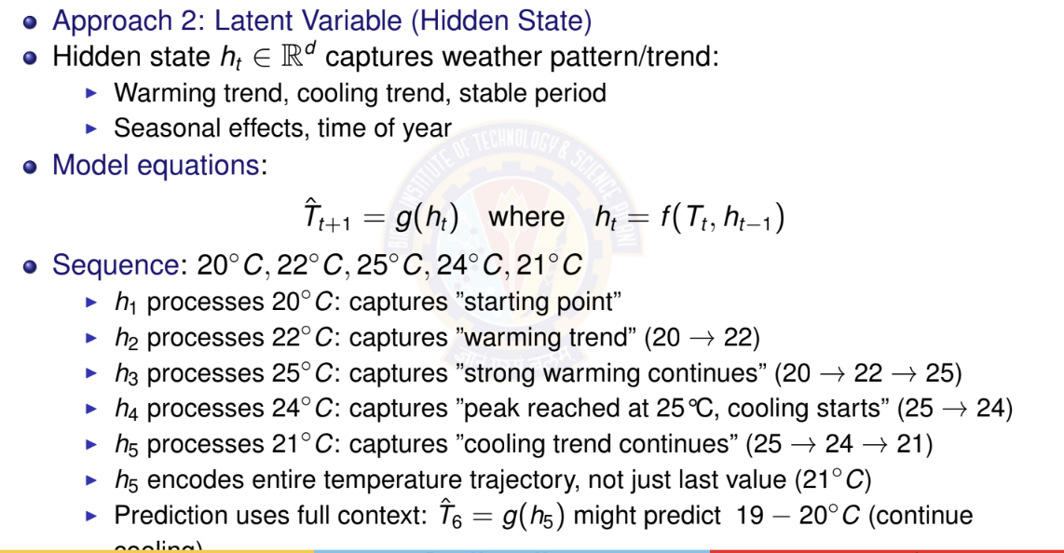
Temperature Forecasting - Latent Variable Model
Deep Neural Network

Slide 17

Table of Contents
Introduction to Sequence Modeling
Sequence Models Theory
Basic RNN Architecture
RNN Training & BPTT
Bidirectional RNNs
Deep (Stacked) RNNs
Gated Recurrent Units (GRU)
Long Short-Term Memory (LSTM)
Time Series Forecasting Applications
Comparison & Summary
1
2
3
4
5
6
7
8
9
10
Deep Neural Network

Slide 18
Recurrent Neural Network (RNN)
Definition
Neural network with loops, allowing information to persist
Key idea:
⁾ Process sequential data one step at a time
⁾ Maintain hidden state that summarizes past information
⁾ Same parameters shared across all time steps
The loop: Hidden state h_{t} feeds
o_{t}
h_{t}
RNN
Recurrent connection
back into itself at next time step
x_{t}
Deep Neural Network

Slide 19
RNN: Unrolled Computation Graph
Unrolling: Visualize RNN across time steps
o₁ o₂ o₃ o₄
same W_{ho}
same W_{ho}
same W_{ho}
same W_{ho}
same W_{hh}
same W_{hh}
same W_{hh}
h₄ · · ·
h₁
h₂
h₃
same W_{hx}
same W_{hx}
same W_{hx}
same W_{hx}
x₁
t = 1
x₂
t = 2
x₃
t = 3
x₄
t = 4
Key insight: Same parameters (W_{hx} , W_{hh}, W_{ho} ) applied at each time step
Deep Neural Network
19 / 96

Slide 20
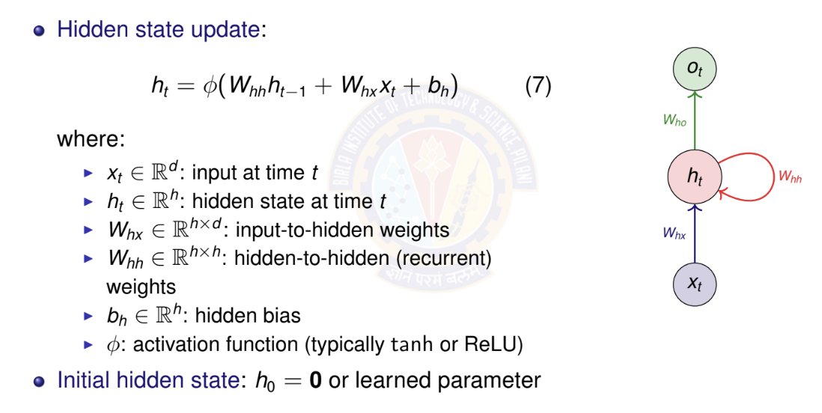
RNN Mathematical Formulation I
Deep Neural Network

Slide 21
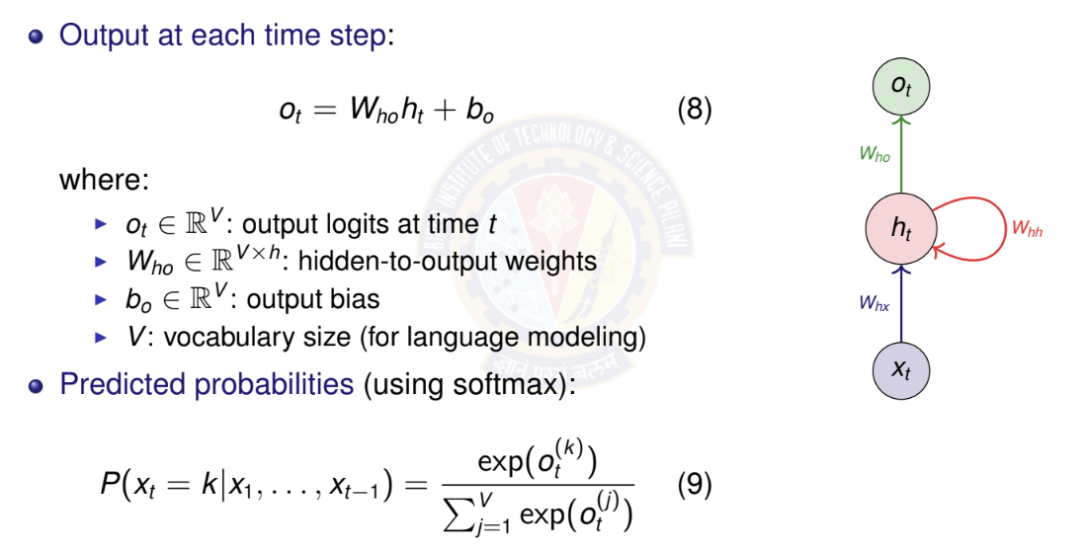
RNN Mathematical Formulation II
Deep Neural Network

Slide 22
Parameter Sharing Across Time
Key insight: Same parameters used at every time step
> W_{hx} , W_{hh} , b_{h} : Shared across all time steps
> W_{ho} , b_{o} : Shared across all time steps
Advantages:
1
Fixed number of parameters regardless of sequence length Can process sequences of any length
Generalization: patterns learned at one position transfer to others
2
3
Contrast with feedforward: Different weights for each position
Deep Neural Network

Slide 23
RNN Parameter Counting
Given:
> Input dimension: d
> Hidden dimension: h
> Output/vocabulary size: V
Parameter count:
W_{hx} : h × d W_{hh} : h × h
b_{h} : h
W_{ho} : V × h b_{o} : V
Total : hd + h² + h + Vh + V = h(d + h + V + 1) + V
Deep Neural Network

Slide 24
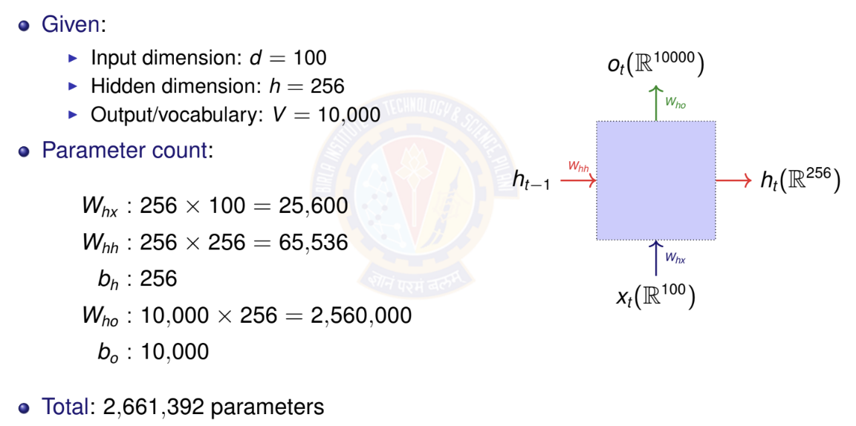
RNN Parameter Counting Example
Deep Neural Network

Slide 25
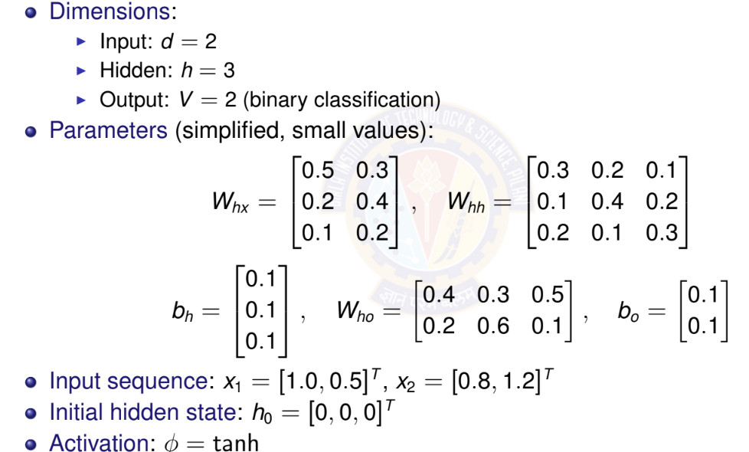
RNN Forward Pass: Simple Example
Deep Neural Network

Slide 26
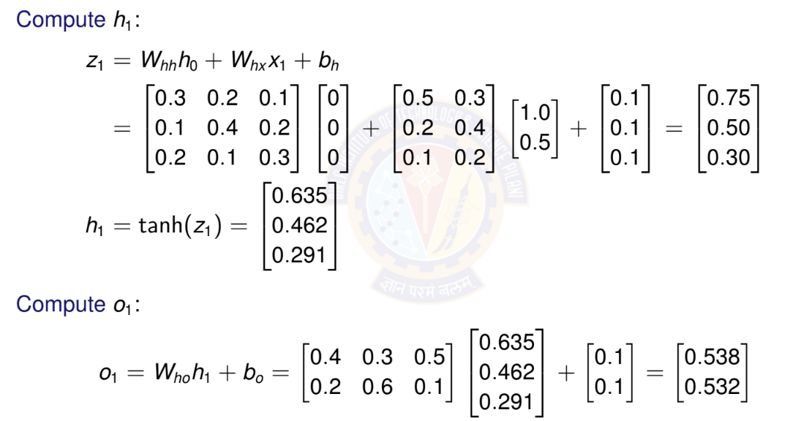
RNN Forward Pass: Time Step t = 1
Deep Neural Network

Slide 27
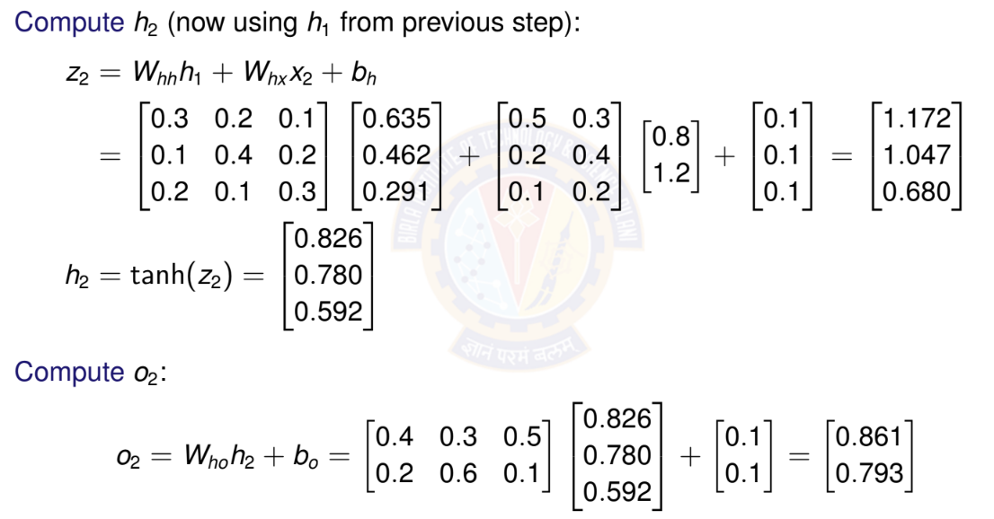
RNN Forward Pass: Time Step t = 2
Deep Neural Network

Slide 28
Activation Functions in RNNs
Common choices for φ:
Hyperbolic tangent (tanh):
⁾ Range: [−1, 1]
⁾ Centered at zero (helps with gradient flow)
⁾ Most common for vanilla RNNs
ReLU:
⁾ Range: [0, ∞)
⁾ Can help with vanishing gradient
⁾ May cause exploding activations
Deep Neural Network

Slide 29

Table of Contents
Introduction to Sequence Modeling
Sequence Models Theory
Basic RNN Architecture
RNN Training & BPTT
Bidirectional RNNs
Deep (Stacked) RNNs
Gated Recurrent Units (GRU)
Long Short-Term Memory (LSTM)
Time Series Forecasting Applications
Comparison & Summary
1
2
3
4
5
6
7
8
9
10
Deep Neural Network

Slide 30
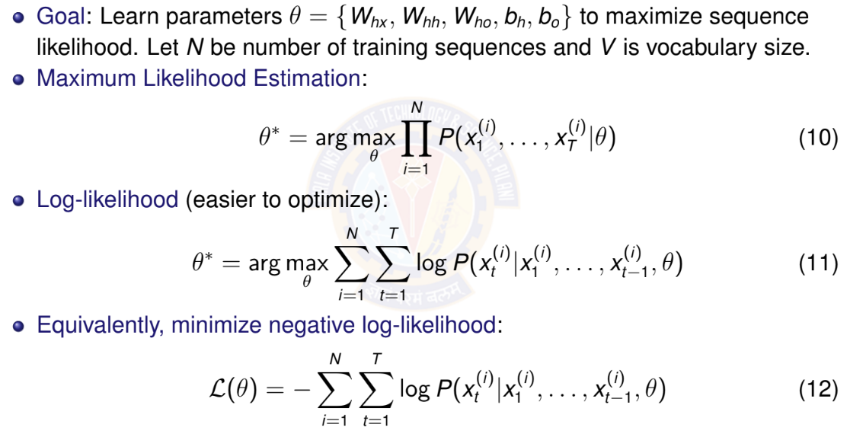
Training Objective for RNNs
Deep Neural Network

Slide 31
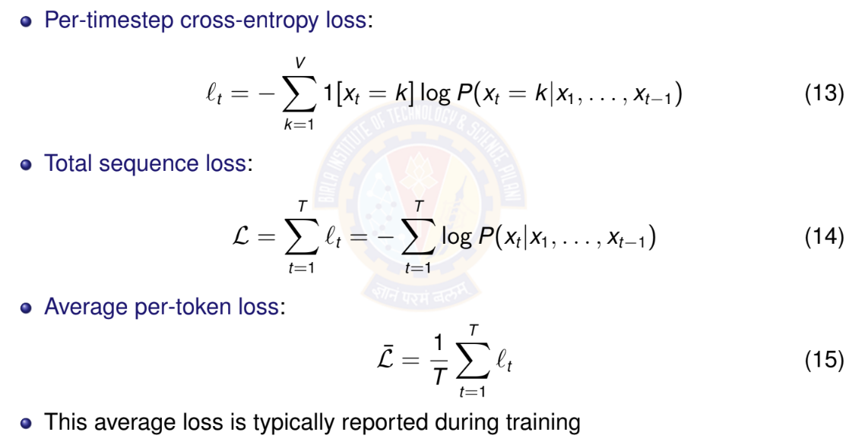
Loss Function for Sequences
Deep Neural Network

Slide 32
Backpropagation Through Time (BPTT)
Challenge: How to compute gradients in RNNs?
⁾ Parameters shared across all time steps
⁾ Hidden state depends on entire history
⁾ Need to backpropagate through time
Key insight: Unroll RNN into feedforward network
⁾ Apply standard backpropagation
⁾ Sum gradients from all time steps (parameter sharing)
BPTT: Backpropagation Through Time
⁾ Forward pass: compute outputs for all time steps
⁾ Backward pass: compute gradients from t = T to t = 1
⁾ Gradients flow backward through time
Deep Neural Network

Slide 33
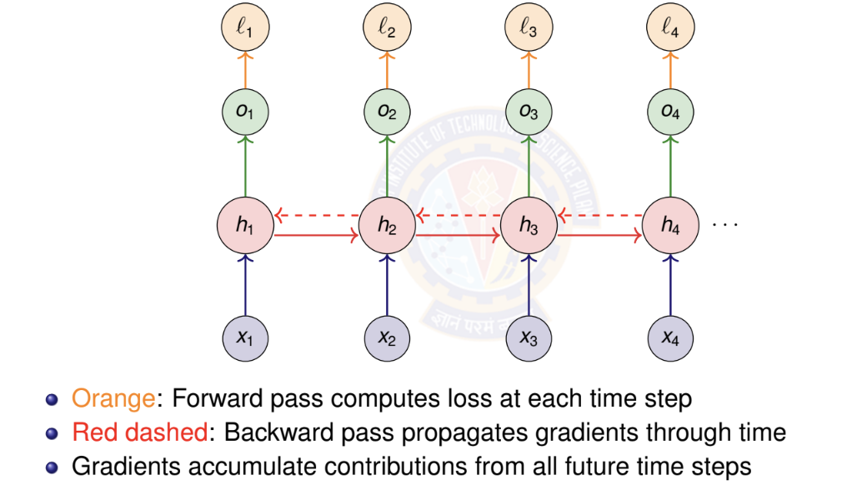
BPTT: Computational Graph
Deep Neural Network

Slide 34
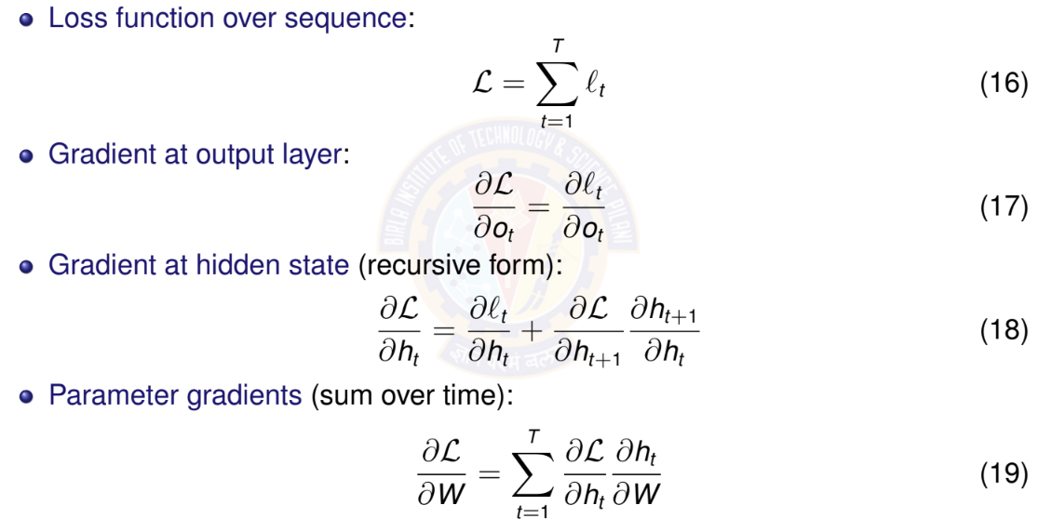
BPTT: Key Gradient Equations
Deep Neural Network

Slide 35
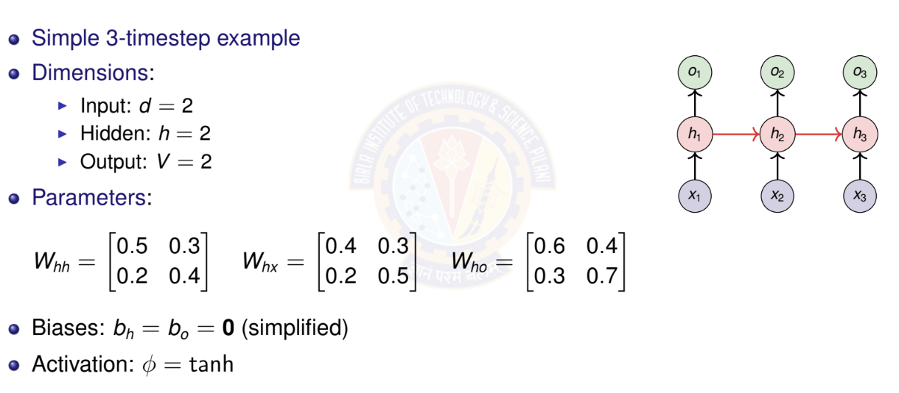
BPTT: Numerical Example Setup
Deep Neural Network

Slide 36
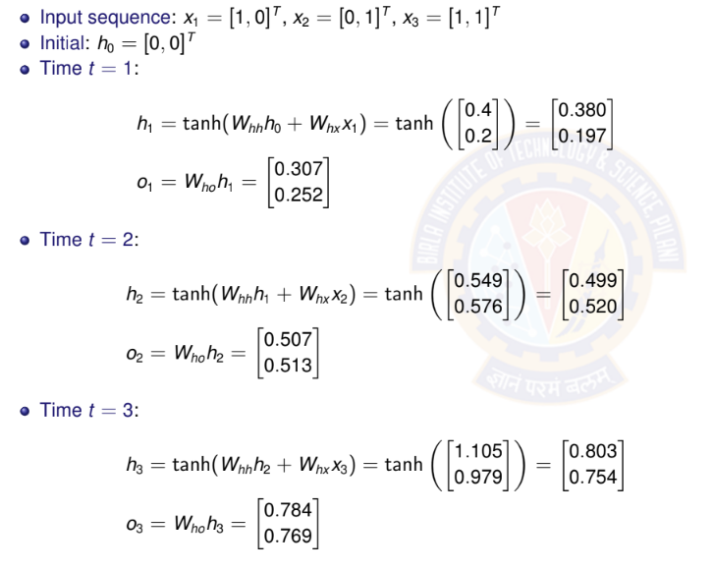
BPTT: Forward Pass
Deep Neural Network

Slide 37
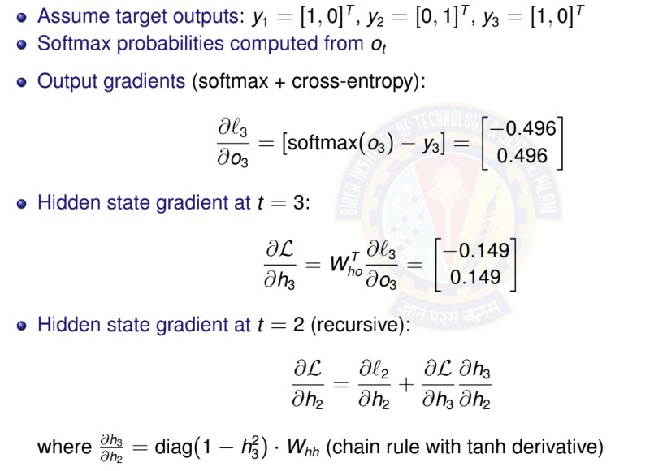
BPTT: Backward Pass
Deep Neural Network

Slide 38
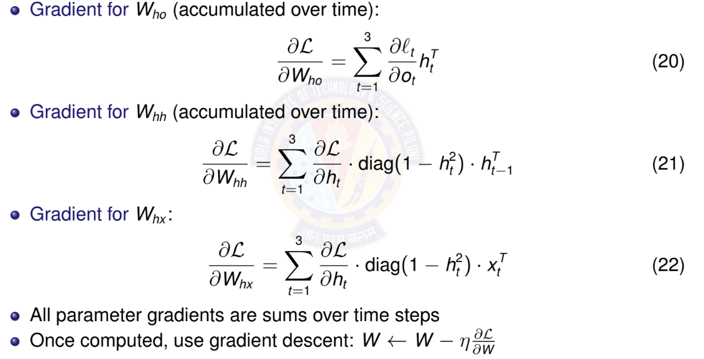
BPTT: Parameter Gradients
Deep Neural Network

Slide 39
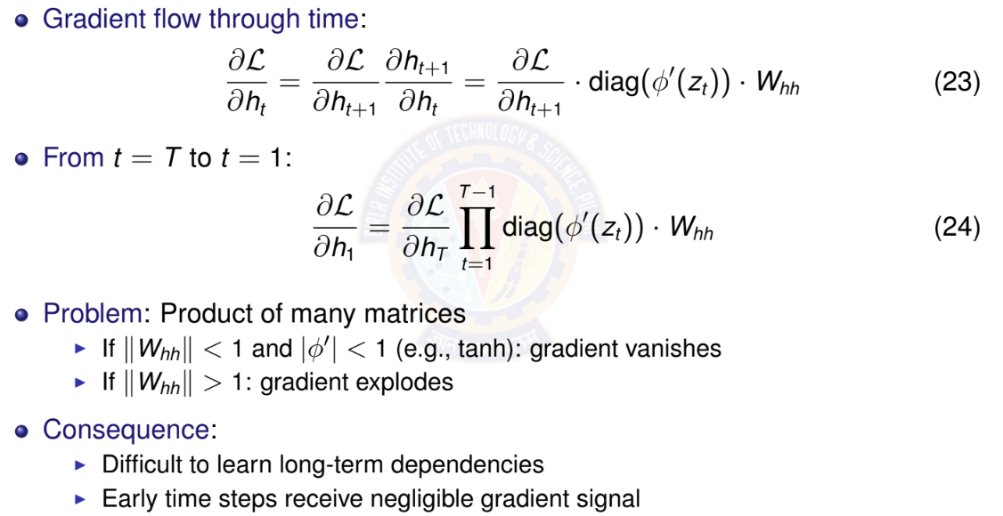
Vanishing Gradients: The Problem
Deep Neural Network

Slide 40
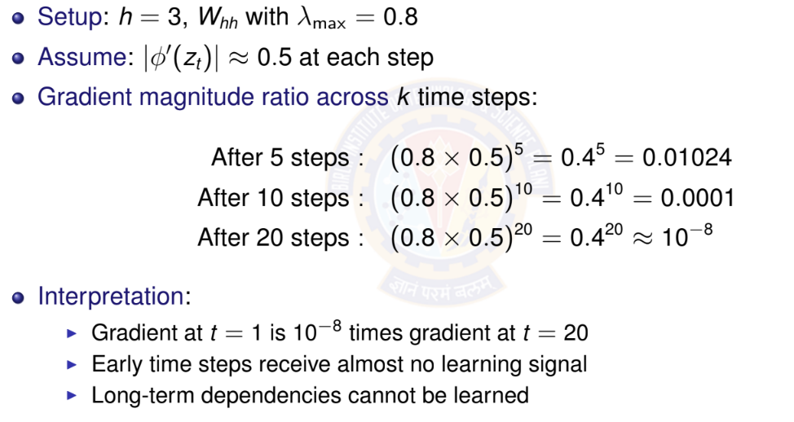
Vanishing Gradients: Numerical Example
Deep Neural Network

Slide 41
Why Vanishing Gradients are Problematic?
Learning difficulty:
⁾ Parameters affecting early time steps barely update
⁾ Model cannot learn long-term patterns
⁾ Training becomes ineffective for long sequences
Example scenarios where this fails:
⁾ ”I grew up in France... [50 words]... I speak fluent ”
⁾ Long-range syntactic dependencies in language
⁾ Time series with seasonal patterns (yearly cycles)
Solutions:
⁾ Better architectures: LSTM, GRU
⁾ Careful initialization
⁾ Skip connections
Deep Neural Network

Slide 42

Table of Contents
Introduction to Sequence Modeling
Sequence Models Theory
Basic RNN Architecture
RNN Training & BPTT
Bidirectional RNNs
Deep (Stacked) RNNs
Gated Recurrent Units (GRU)
Long Short-Term Memory (LSTM)
Time Series Forecasting Applications
Comparison & Summary
1
2
3
4
5
6
7
8
9
10
Deep Neural Network

Slide 43
Bidirectional RNNs: Motivation
Limitation of standard RNN: Only uses past context
⁾ Predicts based on x₁, . . . , x_{t —1}
⁾ Cannot use future information
Many tasks benefit from full context:
⁾ Sentiment analysis: ”The movie was not ” (need to see ”good” or ”bad”)
⁾ Named entity recognition: ”I met Paris in Paris” (person vs city - need full context)
⁾ Speech recognition: Future phonemes help disambiguate current sound
⁾ Machine translation: Full sentence context improves translation
Key idea: Process sequence in both directions
⁾ Forward RNN: left-to-right
⁾ Backward RNN: right-to-left
⁾ Combine information from both
Deep Neural Network

Slide 44
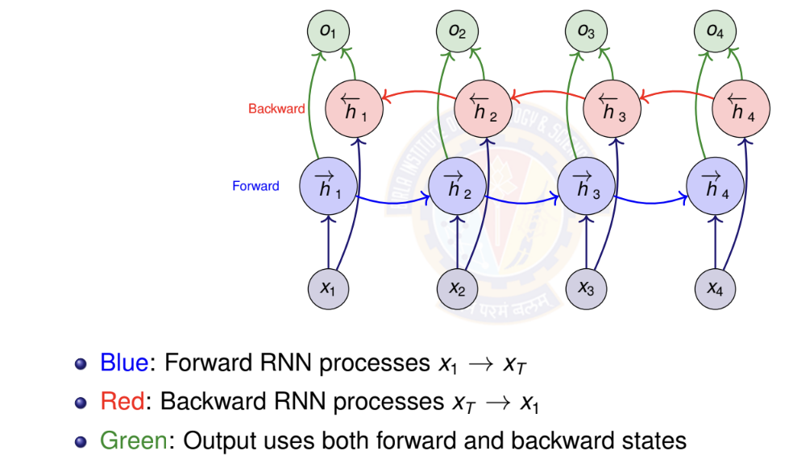
Bidirectional RNN Architecture
Deep Neural Network

Slide 45
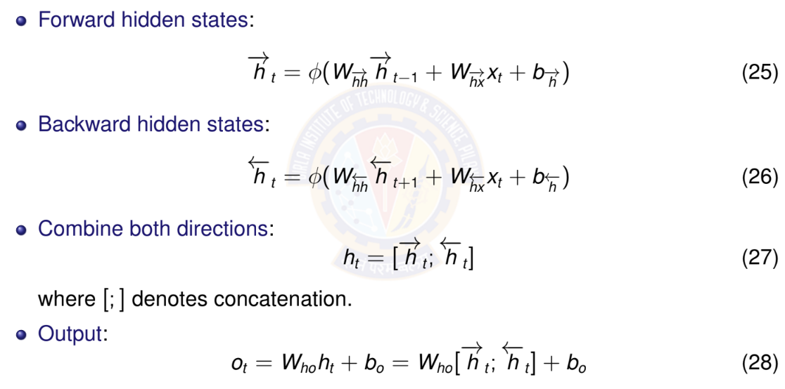
Bidirectional RNN: Mathematical Formula
Deep Neural Network

Slide 46
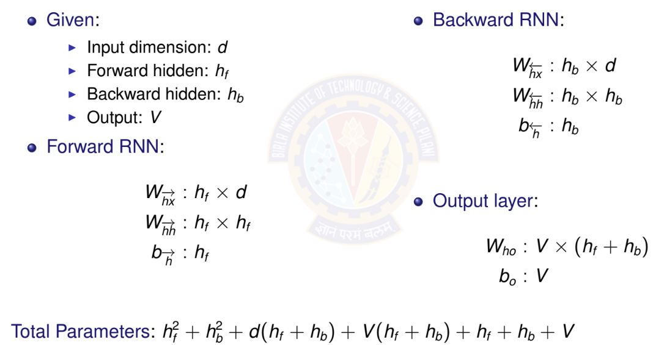
Bidirectional RNN: Parameter Counting
Deep Neural Network

Slide 47
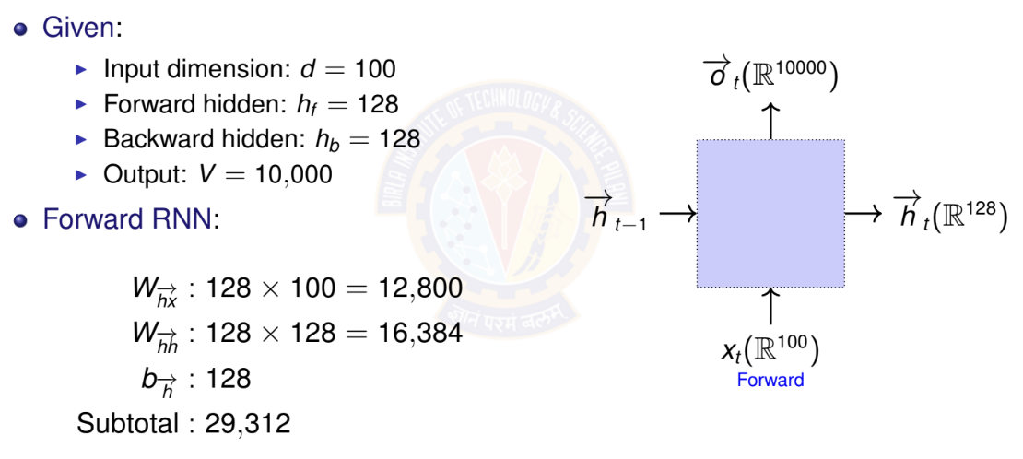
Example Bidirectional RNN: Parameter Counting
Deep Neural Network

Slide 48
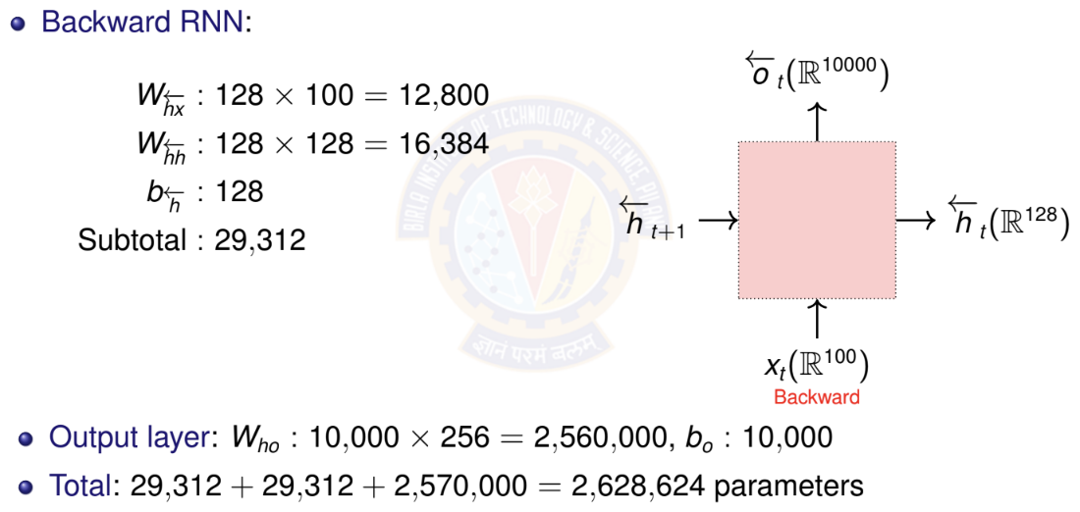
Example Bidirectional RNN: Parameter Counting
Deep Neural Network

Slide 49
When to Use Bidirectional RNNs
Use bidirectional RNNs when:
⁾ Entire sequence available before prediction
⁾ Task benefits from future context
⁾ Examples: text classification, named entity recognition, machine translation (encoder)
Do NOT use when:
⁾ Real-time/online prediction required
⁾ Causal modeling (future cannot influence past)
⁾ Examples: language modeling, real-time speech recognition, time series forecasting
Key limitation: Must process entire sequence
⁾ Cannot make predictions until sequence complete
⁾ Higher computational cost (two RNNs)
⁾ Not suitable for streaming applications
Deep Neural Network

Slide 50

Table of Contents
Introduction to Sequence Modeling
Sequence Models Theory
Basic RNN Architecture
RNN Training & BPTT
Bidirectional RNNs
Deep (Stacked) RNNs
Gated Recurrent Units (GRU)
Long Short-Term Memory (LSTM)
Time Series Forecasting Applications
Comparison & Summary
1
2
3
4
5
6
7
8
9
10
Deep Neural Network

Slide 51
Deep (Stacked) RNNs: Motivation
Why stack RNN layers?
⁾ Single RNN layer: limited representational capacity
⁾ Deep networks learn hierarchical features
⁾ Lower layers: simple patterns
⁾ Higher layers: complex, abstract patterns
Examples of hierarchical features:
⁾ Text: characters → words → phrases → sentences
⁾ Speech: phonemes → syllables → words
⁾ Time series: short-term → medium-term → long-term trends
Empirical observation:
⁾ Deeper RNNs often outperform wider single-layer RNNs
⁾ Typical depth: 2-4 layers (diminishing returns beyond this)
Deep Neural Network

Slide 52
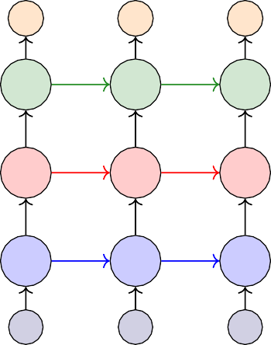
Deep RNN Architecture
Each layer processes output of previous layer
Horizontal arrows: recurrent connections within layer
Vertical arrows:
feed-forward connections between layers
 | o₁ | o₂ | o₃
Layer 3 | _{h}(3) | _{h}(3) | _{h}(3) 3
Layer 2 | _{h}(2) | _{h}(2) | _{h}(2) 3
Layer 1 | _{h}(1) | _{h}(1) | _{h} (1)
1
2
1
2
1
2
3
x₁
x₂
x₃
Deep Neural Network

Slide 53
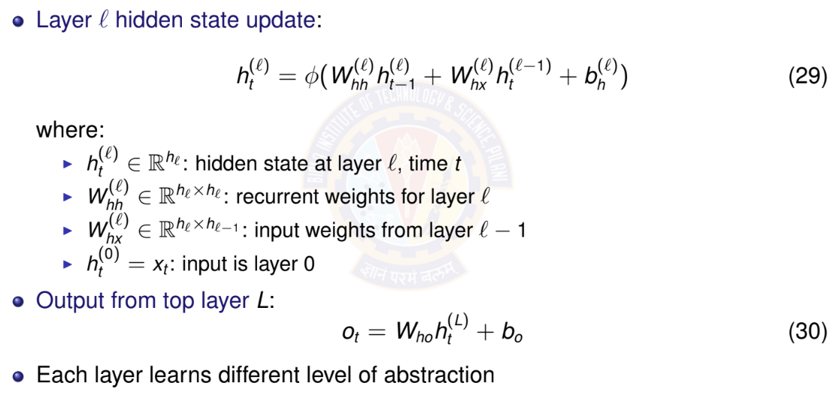
Deep RNN: Mathematical Formulation
Deep Neural Network

Slide 54
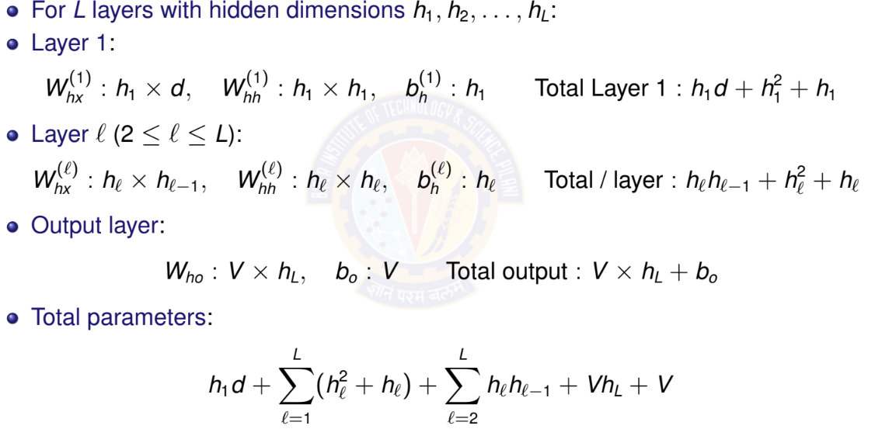
Deep RNN: Parameter Counting
Deep Neural Network

Slide 55
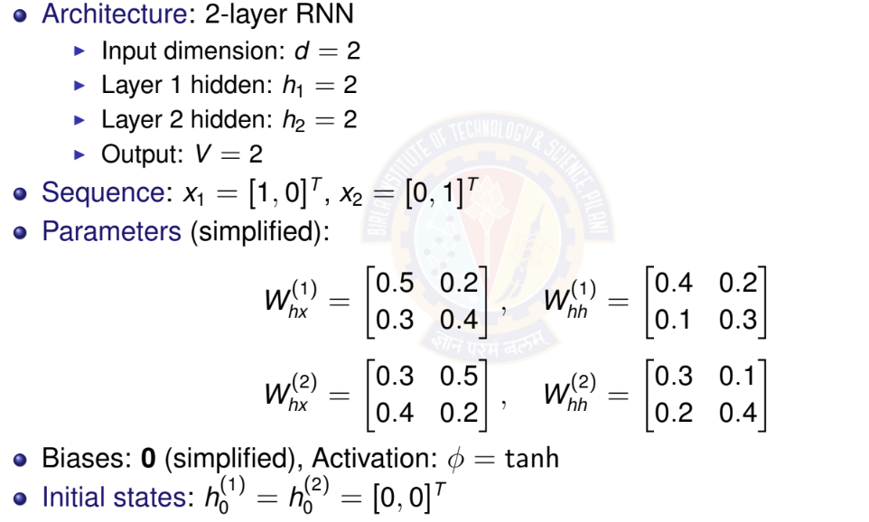
Deep RNN: Numerical Example Setup
Deep Neural Network

Slide 56
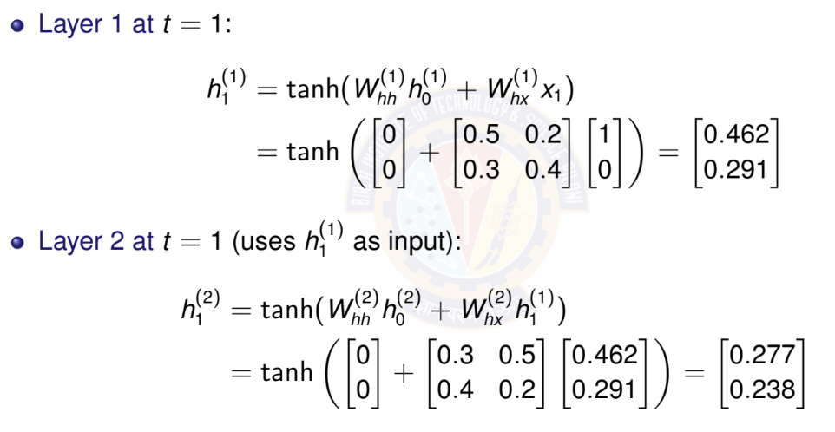
Deep RNN: Forward Pass at t = 1
Deep Neural Network

Slide 57
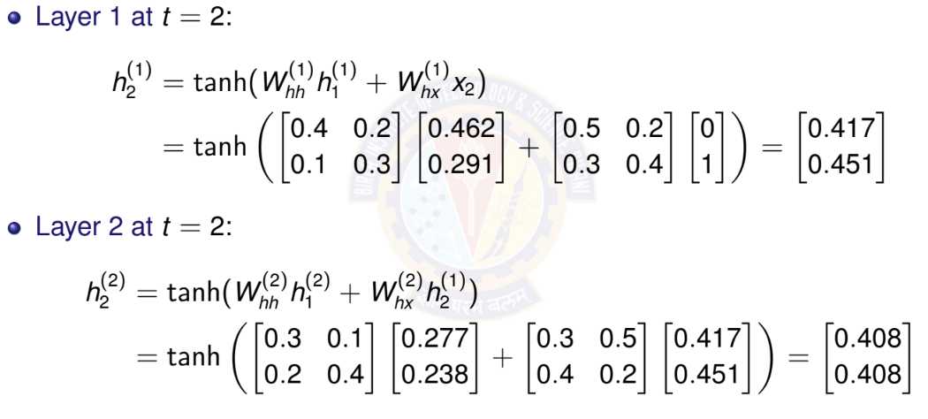
Deep RNN: Forward Pass at t = 2
Deep Neural Network

Slide 58
Deep RNN: Gradient Flow Considerations
Gradient must flow through:
⁾ Time (horizontal connections within each layer)
⁾ Depth (vertical connections between layers)
Compound vanishing gradient problem:
⁾ Gradients vanish in time dimension (as in single-layer RNN)
⁾ Additional vanishing through depth
⁾ Problem is more severe than single-layer RNN
Mitigation strategies:
⁾ Use LSTM/GRU cells instead of vanilla RNN (upcoming)
⁾ Skip connections between layers (residual connections)
⁾ Careful initialization
⁾ Layer normalization
Practical limit: Typically 2-4 layers
⁾ Deeper networks harder to train
⁾ Diminishing returns beyond 4 layers
Deep Neural Network

Slide 59

Table of Contents
Introduction to Sequence Modeling
Sequence Models Theory
Basic RNN Architecture RNN Training & BPTT
Bidirectional RNNs
Deep (Stacked) RNNs
Gated Recurrent Units (GRU)
Long Short-Term Memory (LSTM)
Time Series Forecasting Applications
Comparison & Summary
1
2
3
4
5
6
7
8
9
10
Deep Neural Network

Slide 60
GRU: Motivation
Vanilla RNN problems:
⁾ Vanishing gradients prevent learning long-term dependencies
⁾ All information in hidden state weighted equally
⁾ No mechanism to selectively remember or forget
Key insight: Use gates to control information flow
⁾ Gates: Neural network layers with sigmoid activation σ ∈ [0, 1]
⁾ σ = 0: Block information completely
⁾ σ = 1: Let all information pass through
⁾ σ ∈ (0, 1): Partially allow information
GRU advantages:
⁾ Learn what to remember and what to forget
⁾ Better gradient flow through time
⁾ Can capture long-term dependencies
⁾ Fewer parameters than LSTM
Deep Neural Network

Slide 61
GRU: Architecture Overview
Two gates:
⁾ Reset gate r_{t} : Controls how much past information to forget
⁾ Update gate z_{t} : Controls how much to update hidden state
Candidate hidden state h˜_{t} : Proposed new content
Final hidden state h_{t} : Interpolation between old and new
All gates learned from data
o_{t}
z_{t}
GRU
r_{t}
^{h}t —1
h_{t}
x_{t}
Deep Neural Network

Slide 62
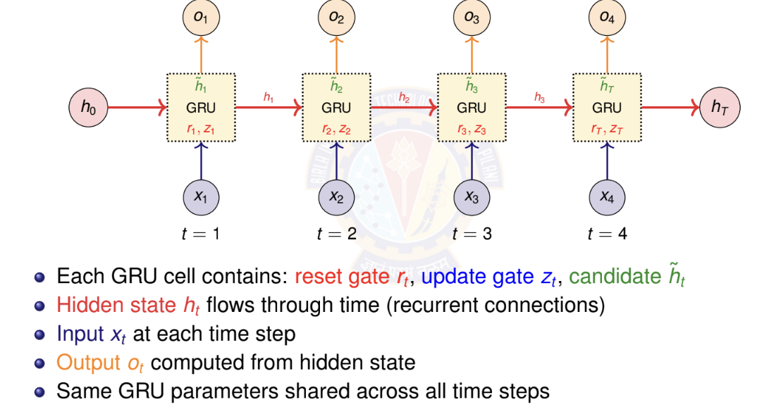
GRU: Unrolled Architecture Across Time
h
T
Deep Neural Network

Slide 63
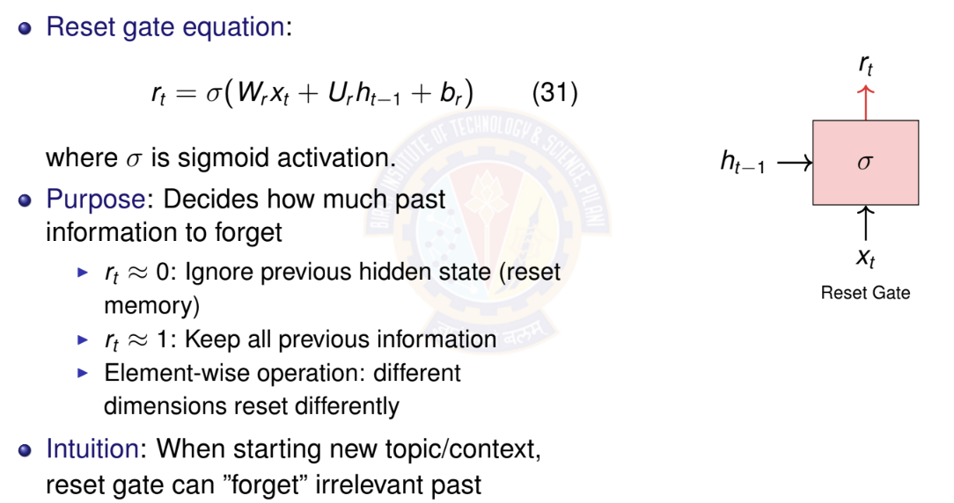
GRU: Reset Gate
Deep Neural Network

Slide 64
GRU: Update Gate
Update gate equation:
z_{t}
z_{t} = σ(W_{z}x_{t} + U_{z}h_{t —1} + b_{z} )
Purpose: Decides how much to update hidden state
(32)
σ
^{h}t —1
⁾ z_{t} ≈ 0: Keep old hidden state h_{t —1} (don’t update)
⁾ z_{t} ≈ 1: Replace with new candidate h˜_{t} (full update)
⁾ Acts like a ”memory gate”
Intuition: For long-term dependencies, keep
z_{t} small to preserve information
x_{t}
Update Gate
Deep Neural Network

Slide 65
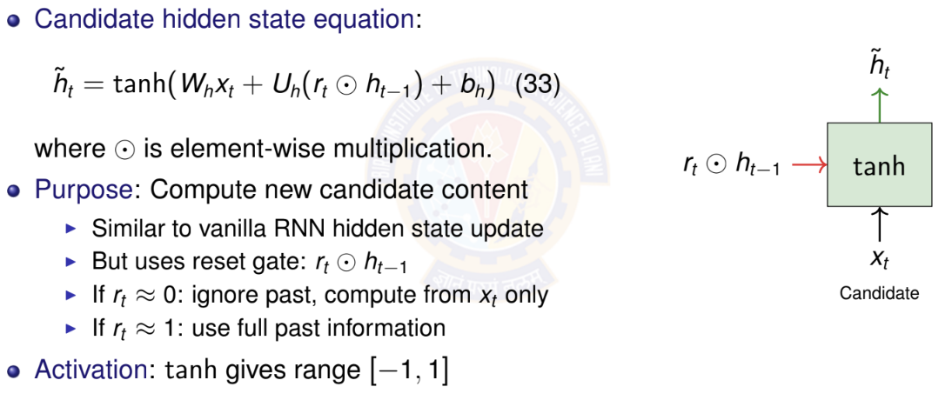
GRU: Candidate Hidden State
Deep Neural Network

Slide 66
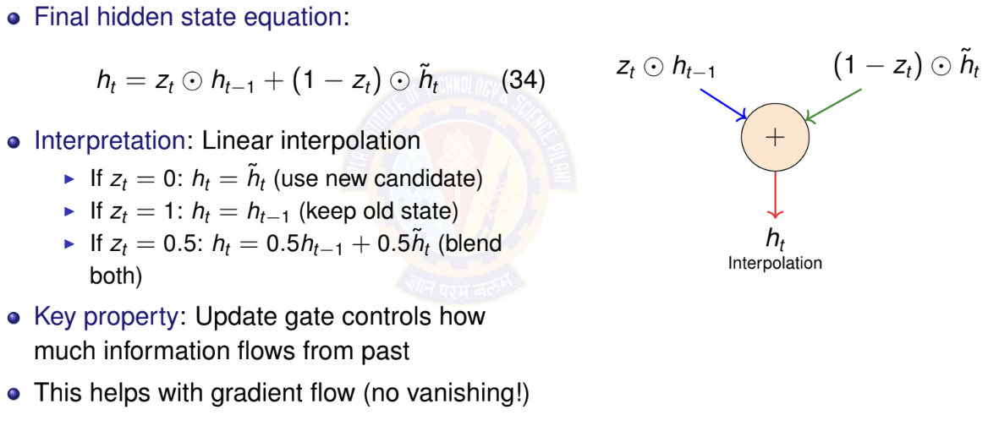
GRU: Final Hidden State Update
Deep Neural Network

Slide 67
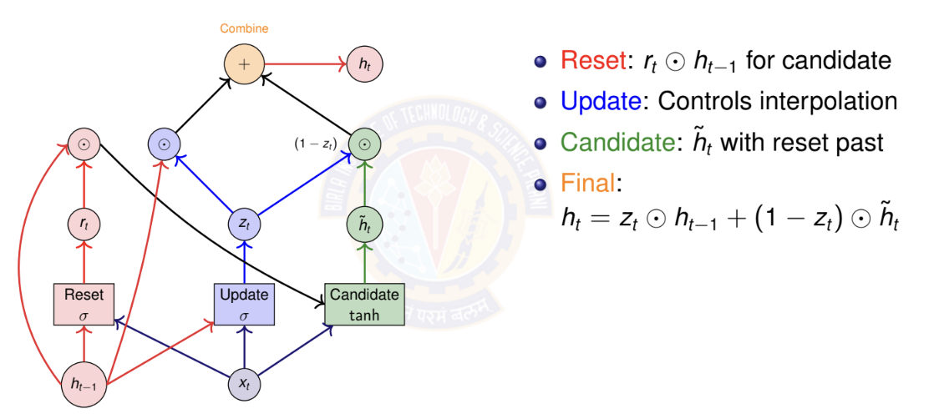
GRU: Computational Graph
Deep Neural Network

Slide 68
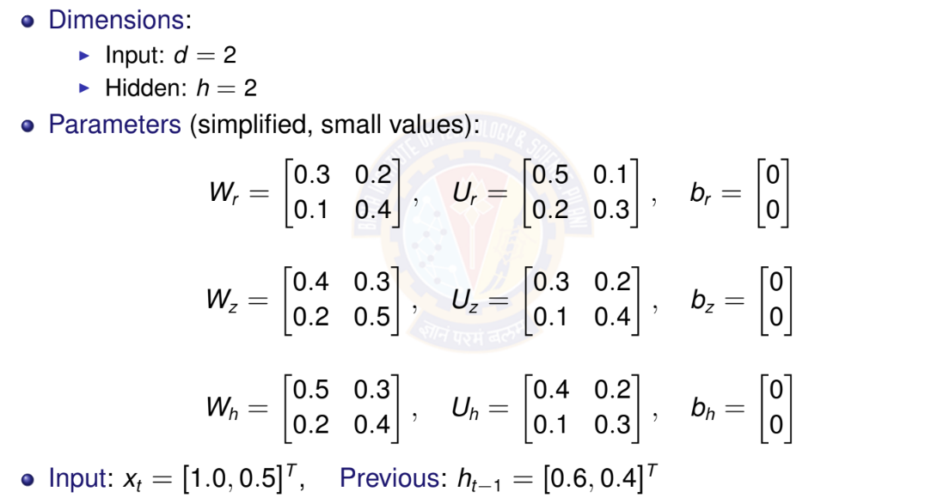
GRU: Numerical Example - Setup
Deep Neural Network

Slide 69
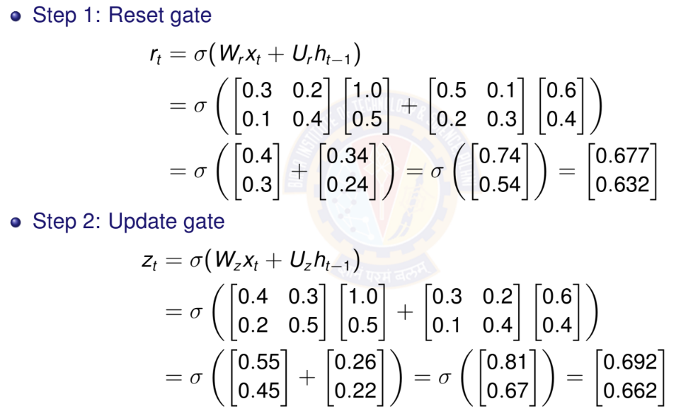
GRU: Numerical Example - Gates Computation
Deep Neural Network

Slide 70
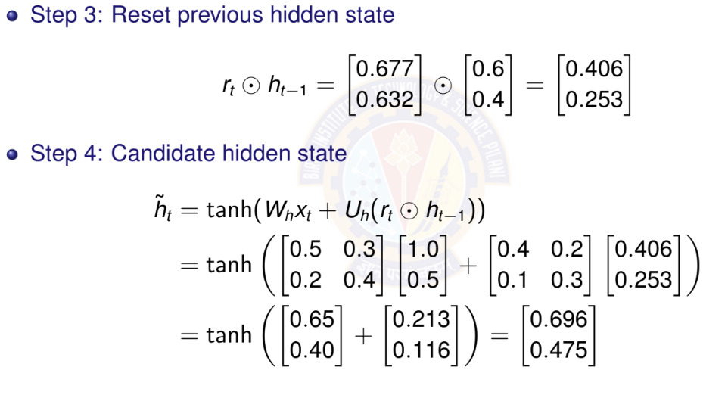
GRU: Numerical Example - Hidden State Update
Deep Neural Network

Slide 71
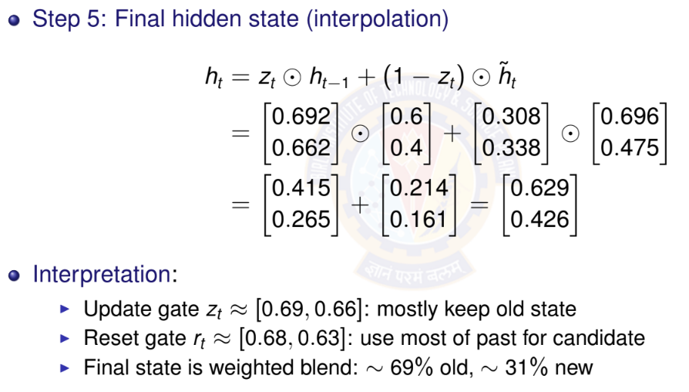
GRU: Numerical Example - Final Hidden State
Deep Neural Network

Slide 72
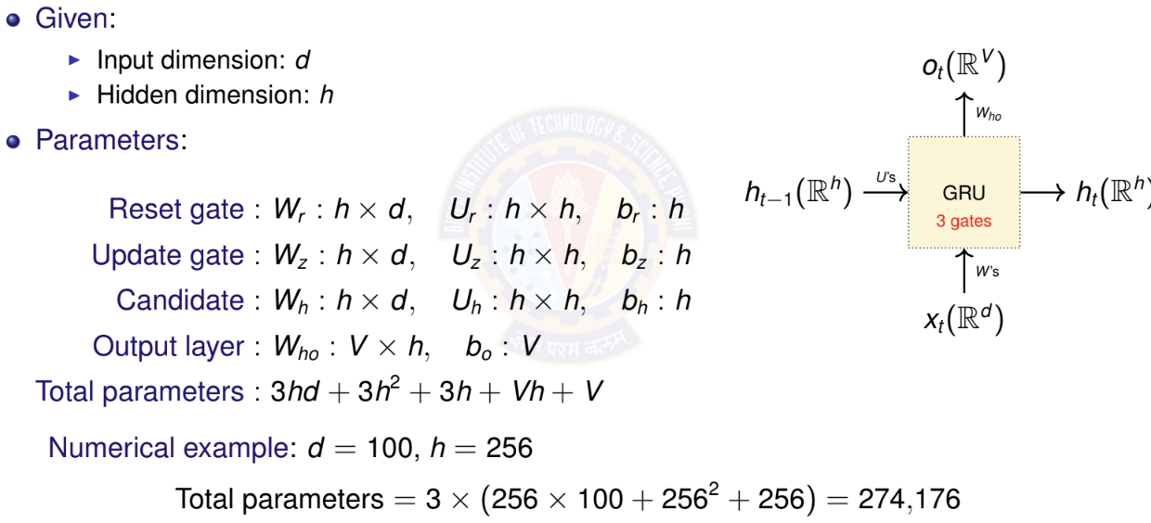
GRU: Parameter Counting
Deep Neural Network

Slide 73
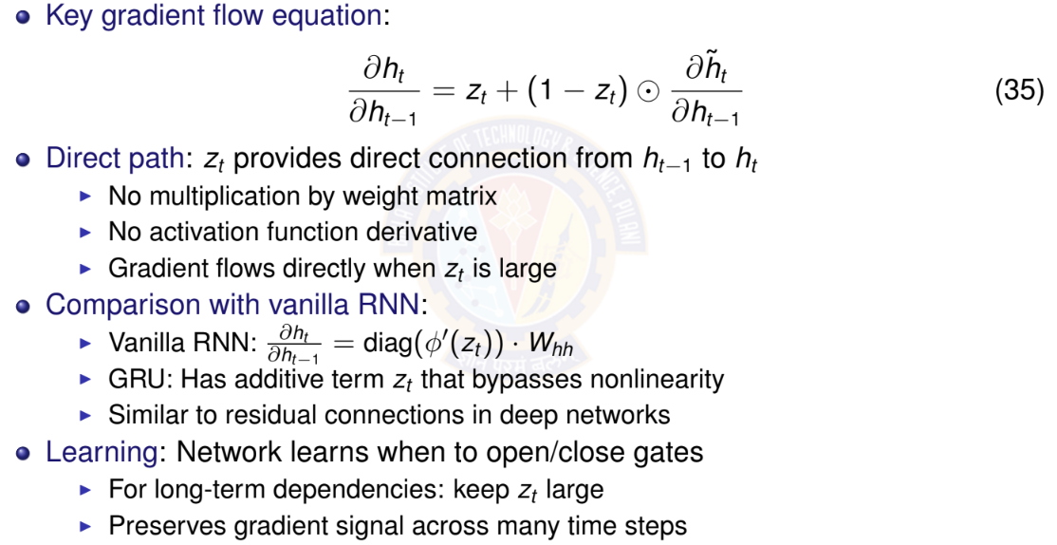
GRU: Why It Helps with Vanishing Gradients
Deep Neural Network

Slide 74

Table of Contents
Introduction to Sequence Modeling
Sequence Models Theory
Basic RNN Architecture
RNN Training & BPTT
Bidirectional RNNs
Deep (Stacked) RNNs
Gated Recurrent Units (GRU)
Long Short-Term Memory (LSTM)
Time Series Forecasting Applications
Comparison & Summary
1
2
3
4
5
6
7
8
9
10
Deep Neural Network

Slide 75
LSTM: Motivation
GRU limitations:
⁾ Single hidden state combines both long-term and short-term information
⁾ Update gate controls both memory and output together
⁾ Less explicit control over information flow
LSTM innovation: Separate memory from hidden state
⁾ Cell state c_{t} : Long-term memory (information highway)
⁾ Hidden state h_{t} : Short-term memory (working memory)
⁾ More fine-grained control with 3 gates instead of 2
Key advantages:
⁾ Cell state provides uninterrupted gradient flow
⁾ Forget gate can selectively remove information
⁾ Output gate separates what to remember from what to output
⁾ Better for very long sequences (100+ time steps)
Most widely used RNN variant in practice
Deep Neural Network

Slide 76
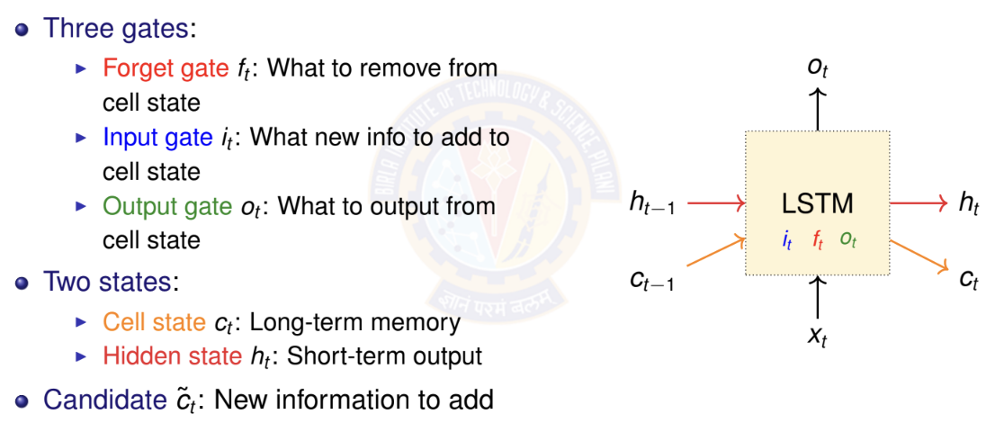
LSTM: Architecture Overview
Deep Neural Network

Slide 77
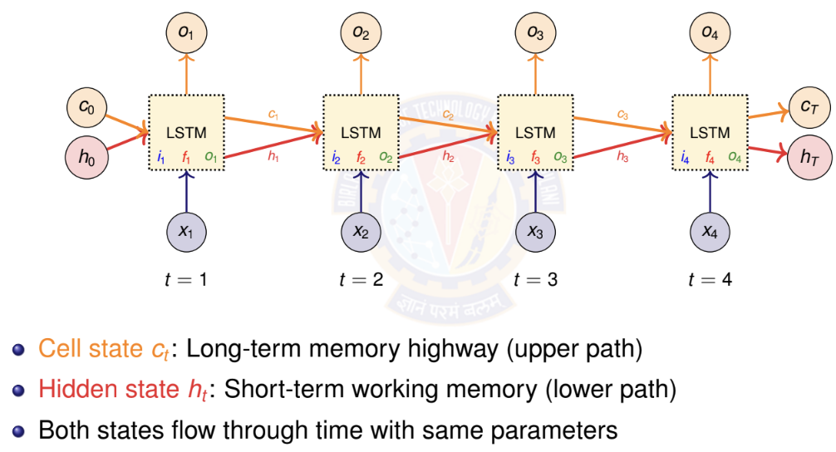
LSTM: Unrolled Architecture Across Time
Deep Neural Network

Slide 78
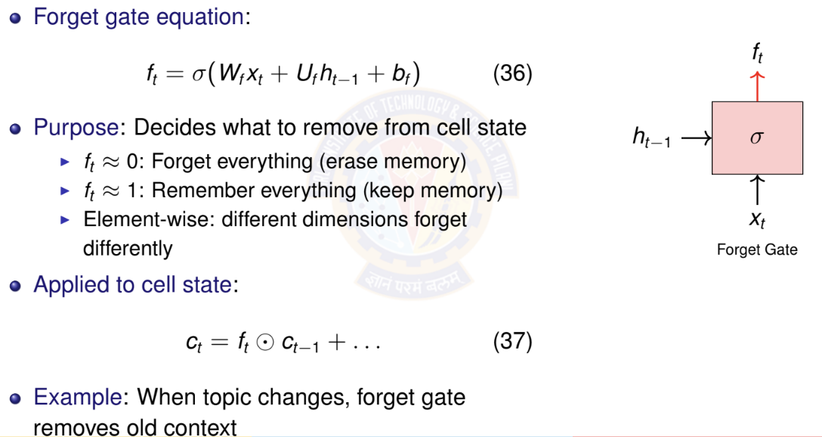
LSTM: Forget Gate
Deep Neural Network

Slide 79
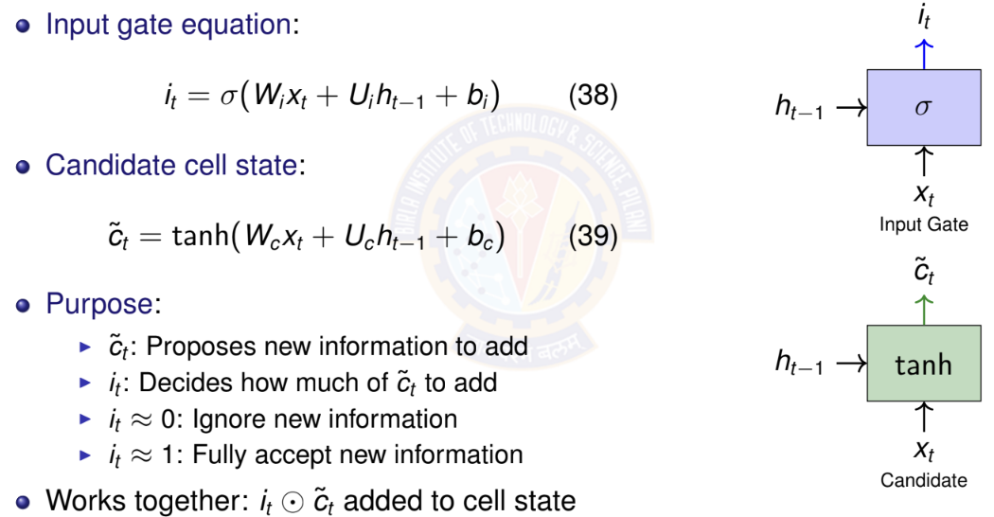
LSTM: Input Gate and Candidate
Deep Neural Network

Slide 80
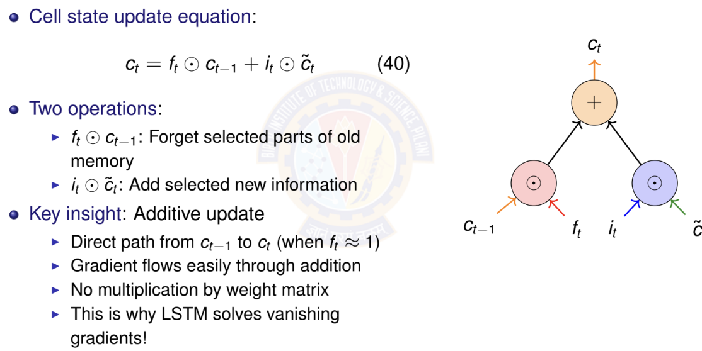
LSTM: Cell State Update
Deep Neural Network

Slide 81
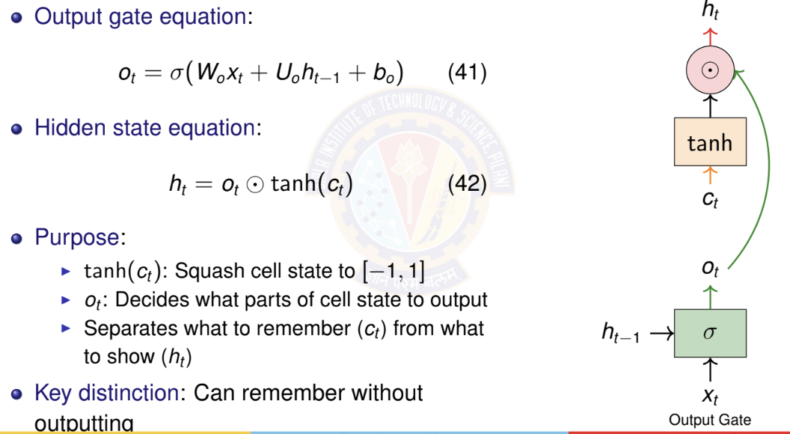
LSTM: Output Gate and Hidden State
outputting
Deep Neural Network

Slide 82
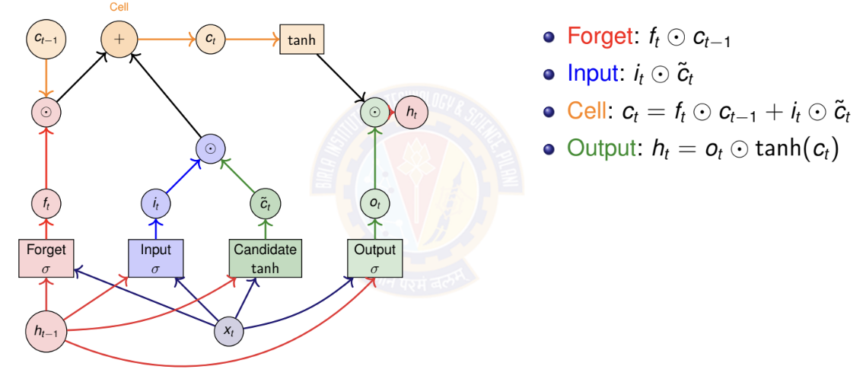
LSTM: Computational Graph
Deep Neural Network

Slide 83
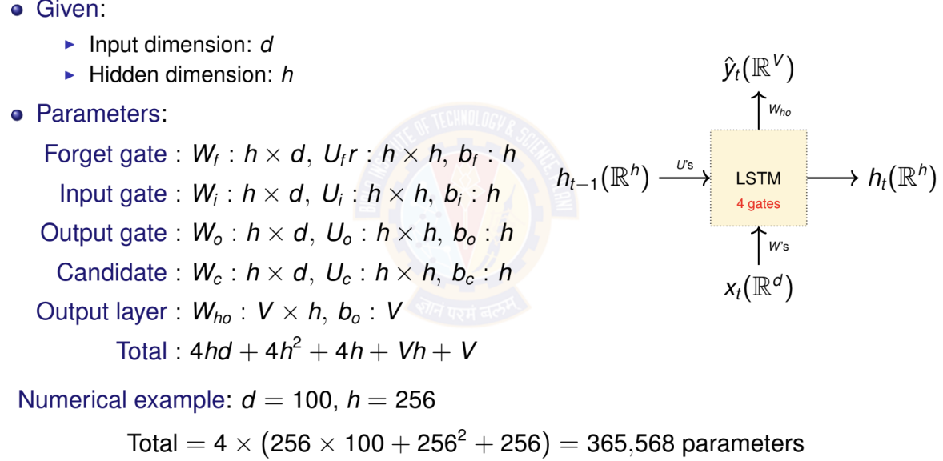
LSTM: Parameter Counting
Deep Neural Network

Slide 84
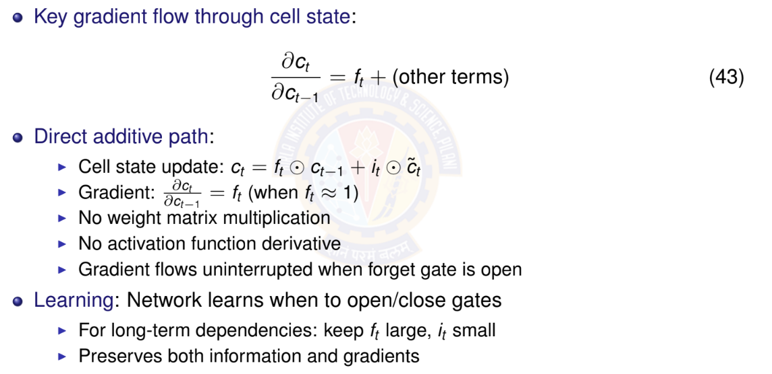
LSTM: Why It Solves Vanishing Gradients
Deep Neural Network
84 / 96

Slide 85
LSTM vs GRU: Comparison
Property | GRU | LSTM
Number of gates | 2 (reset, update) | 3 (forget, input, output)
Memory types | 1 (hidden state) | 2 (cell + hidden)
Parameters | 3(hd + h² + h) | 4(hd + h² + h)
Relative params | Fewer (∼ 25% less) | More
Training speed | Faster | Slower
Memory usage | Lower | Higher
Gradient flow | Good | Excellent
Long sequences | Good (50-100 steps) | Better (100+ steps)
Popularity | Increasing | Most widely used
When to use GRU: Smaller datasets, shorter sequences, faster training
When to use LSTM: Longer sequences, more data available, maximum performance needed
Deep Neural Network

Slide 86

Table of Contents
Introduction to Sequence Modeling
Sequence Models Theory
Basic RNN Architecture
RNN Training & BPTT
Bidirectional RNNs
Deep (Stacked) RNNs
Gated Recurrent Units (GRU)
Long Short-Term Memory (LSTM)
Time Series Forecasting Applications
Comparison & Summary
1
2
3
4
5
6
7
8
9
10
Deep Neural Network

Slide 87

Time Series Forecasting with RNNs
Deep Neural Network

Slide 88

Univariate vs Multivariate Time Series
> Multivariate advantage: Captures cross-variable dependencies
> Example: Humidity affects temperature Prediction.
88 / 96

Slide 89


Forecasting Architectures: Output Types
Single-Step (Univariate Output) Predict only next time step Output: x^{ˆ}_{t +1} ∈ R
Most common approach
Multi-Step (Multivariate Output) Predict multiple future steps Output: [x^{ˆ}_{t +1}, x^{ˆ}_{t +2}, . . . , x^{ˆ}_{t +k} ]
Direct prediction
^{xˆ}t +1 ^{xˆ}t +2 ^{xˆ}t +3
^{xˆ}t +1
x₁
x₂ x₃
Many-to-One
x₄
x₁
x₂ x₃ x₄
Many-to-Many
Deep Neural Network

Slide 90

Time Series Forecasting: Complete Example
Deep Neural Network

Slide 91

Evaluation Metrics for Time Series
Deep Neural Network

Slide 92

Table of Contents
Introduction to Sequence Modeling
Sequence Models Theory
Basic RNN Architecture
RNN Training & BPTT
Bidirectional RNNs
Deep (Stacked) RNNs
Gated Recurrent Units (GRU)
Long Short-Term Memory (LSTM)
Time Series Forecasting Applications
Comparison & Summary
1
2
3
4
5
6
7
8
9
10
Deep Neural Network

Slide 93

RNN Architectures: Comparison

Slide 94
Summary: Key Takeaways
RNN fundamentals:
⁾ Recurrent connections enable processing sequences of arbitrary length
⁾ Parameter sharing across time steps
⁾ Hidden state summarizes past information
Challenges and solutions:
⁾ Problem: Vanilla RNN suffers from vanishing/exploding gradients
⁾ Solution: Gating mechanisms (GRU, LSTM) provide controlled information flow
⁾ Gates learn what to remember, forget, and output
Architecture variants:
⁾ Bidirectional RNN: Use both past and future context
⁾ Deep/Stacked RNN: Multiple layers for hierarchical features
⁾ Encoder-Decoder: Variable-length input to variable-length output
Applications:
⁾ Time series forecasting: Stock prices, weather, energy demand
⁾ Natural language: Translation, text generation
Deep Neural Network

Slide 95

References
Zhang, A., Lipton, Z. C., Li, M., & Smola, A. J. (2023). Dive into deep learning. Cambridge University Press. Chapters 6 and 7.
Goodfellow, I., Bengio, Y., Courville, A. (2016). Deep Learning. MIT Press.
Deep Neural Network

